Slide 1
A secure, scalable approach to
student-graded homework for self-reflection
Matthew Ford and Heather Dillon

Slide 2
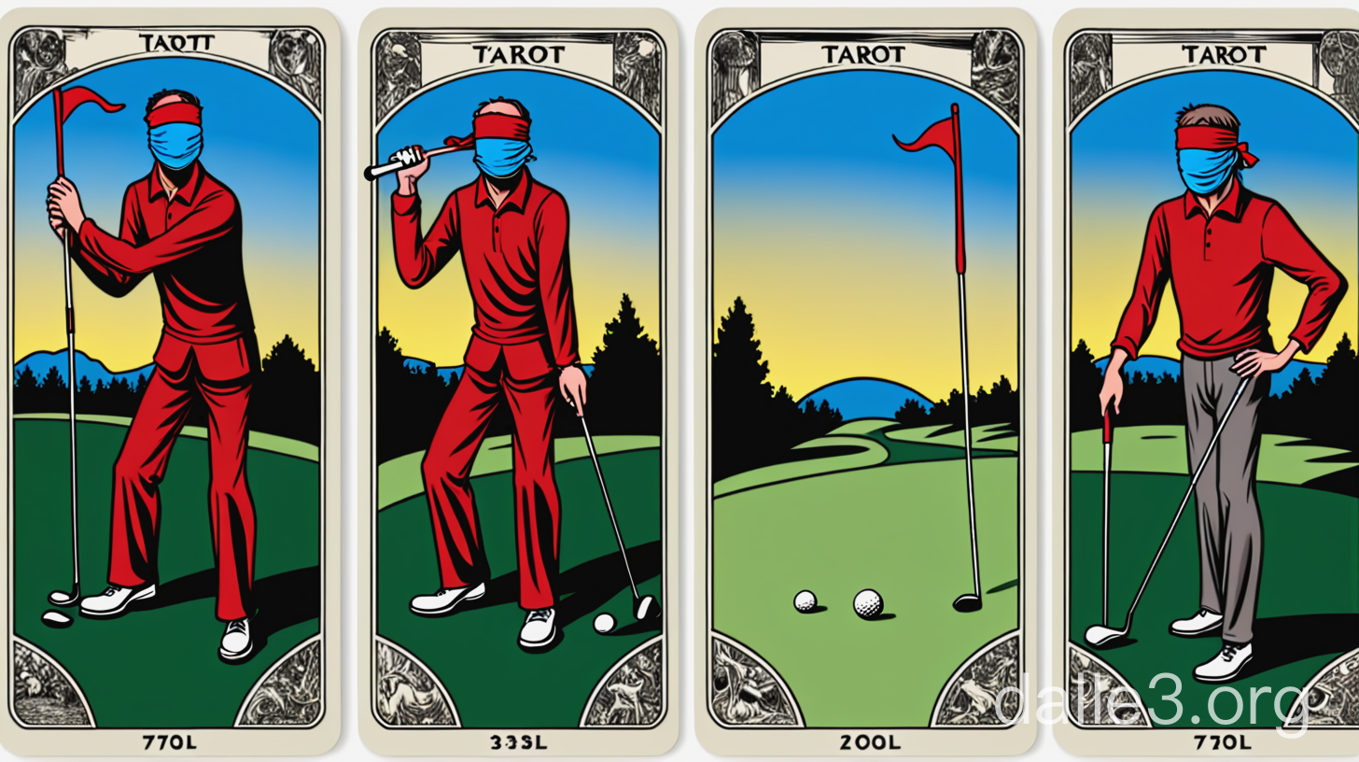
Notes:
Blindfolded golfer
Listened very closely to instructions
Goes to course and hits ball after ball
listens for “plink”
Students
Complete problem after problem, often alone without feedback
Waits for grade

Slide 3
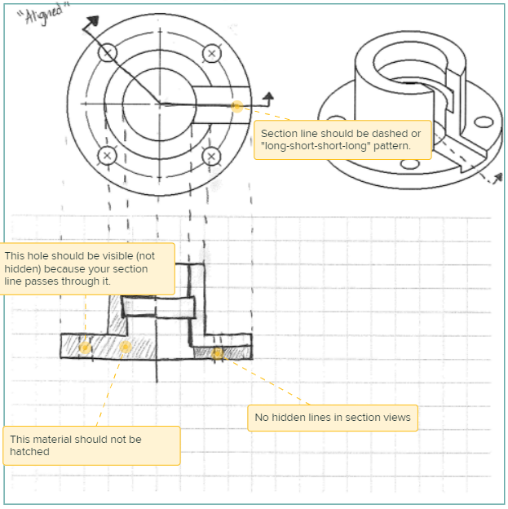
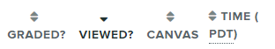

Do students actually read our feedback?
Notes:
How many of you actually enjoy grading?
I spend time …
Few problems with this:
Time lapse
Do students actually look?

Slide 4
Our solution: students grade their own homework.
Design principles
Metrics
Accountability and ownership
Consistency and reliability
Integrity
Timeliness
Grading accuracy
Metacognitive behaviors
Attitudes and workload
Notes:
Accountability & ownership
TRAD: Students rarely view feedback
SELF: Students are accountable for evaluation
Shift in mindset
Consistency
Structured rubrics
Common form
Integrity
One problem is randomly chosen to grade for ALL students
Risk, Confidence in fairness
Timeliness
Adequate study time before quiz

Slide 5


Timeline
Student
Submit homework
Begin self-evaluation
Quiz
Instructor
Assign homework
Post solutions
Random cross-check
Post final scores
Python API
Notes:
Each unit revolves around a quiz (Timeliness)
Self-evaluation with rubric (Consistency)
Students enter their own scores (accountability/ownership)
Random cross-check (integrity)

Slide 6
Structured rubric improves reliability and accuracy.
Category | 2 Points | 1 Point | 0 Points
Diagram(s) | Clear, correct, labeled diagram with all key features | Incorrect diagram, and/or missing features | Missing diagrams
Equations and variables | Correct equations/laws presented in variable form | Equations present, but don’t match diagram or solution method | Missing, incorrect, or incomplete
Solution method | Correct method, neatly documented | Incomplete or incorrect method | Missing or unclear method
Calculations | Error-free and neat. Includes correct units | Missing or incorrect units, or minor errors | Significant errors
Communication | Clear work and relevant reflection | Readable work with marginally-relevant reflection | Messy or missing reflection
Notes:
Categories encourage a structured problem-solving approach
maximum resolution (3 points)…
Specific rubric gives more details about what equations or laws are relevant.
Rubric categories may be used multiple times

Slide 7
Students’ self-scores are mostly accurate and unbiased.
Outliers
Positive bias
Negative bias
Notes:
This figure illustrates a comparison for one homework problem

Slide 8
Students’ self-scores are mostly accurate and unbiased.
Notes:
Explain bias – note nonsignificant values
Note outliers
Note trend in RMS error
Average bias: <5.5%
Average RMS: <15%

Slide 9
Self-grading leads to increased metacognitive activity.
Notes:
This intervention is primarily focused on behaviors, not learning outcomes.
Agreement: 61% - 65%
Disagreement: 4%-22%
Students also spend more time: 20 add’l minutes

Slide 10
Students recognize the value of self-grading
“…it became clear that struggling with the homework was the
only way to have consistently good quiz grades.”
Notes:
We also asked an open-ended survey question:
“How was your experience with self-graded homework? Do you have any suggestions to improve the process?”
Informal sentiment analysis: 65% positive, 30% neutral, 1 negative (logistics)
Student comments reference metacognitive behaviors and value of reflection
Want more guidance -> consider a “Homework zero” training

Slide 11

Questions? Comments? Suggestions?
If you use Canvas, scan the QR to download the Python code.
Thank you!

Slide 12


Slide 13


Slide 14
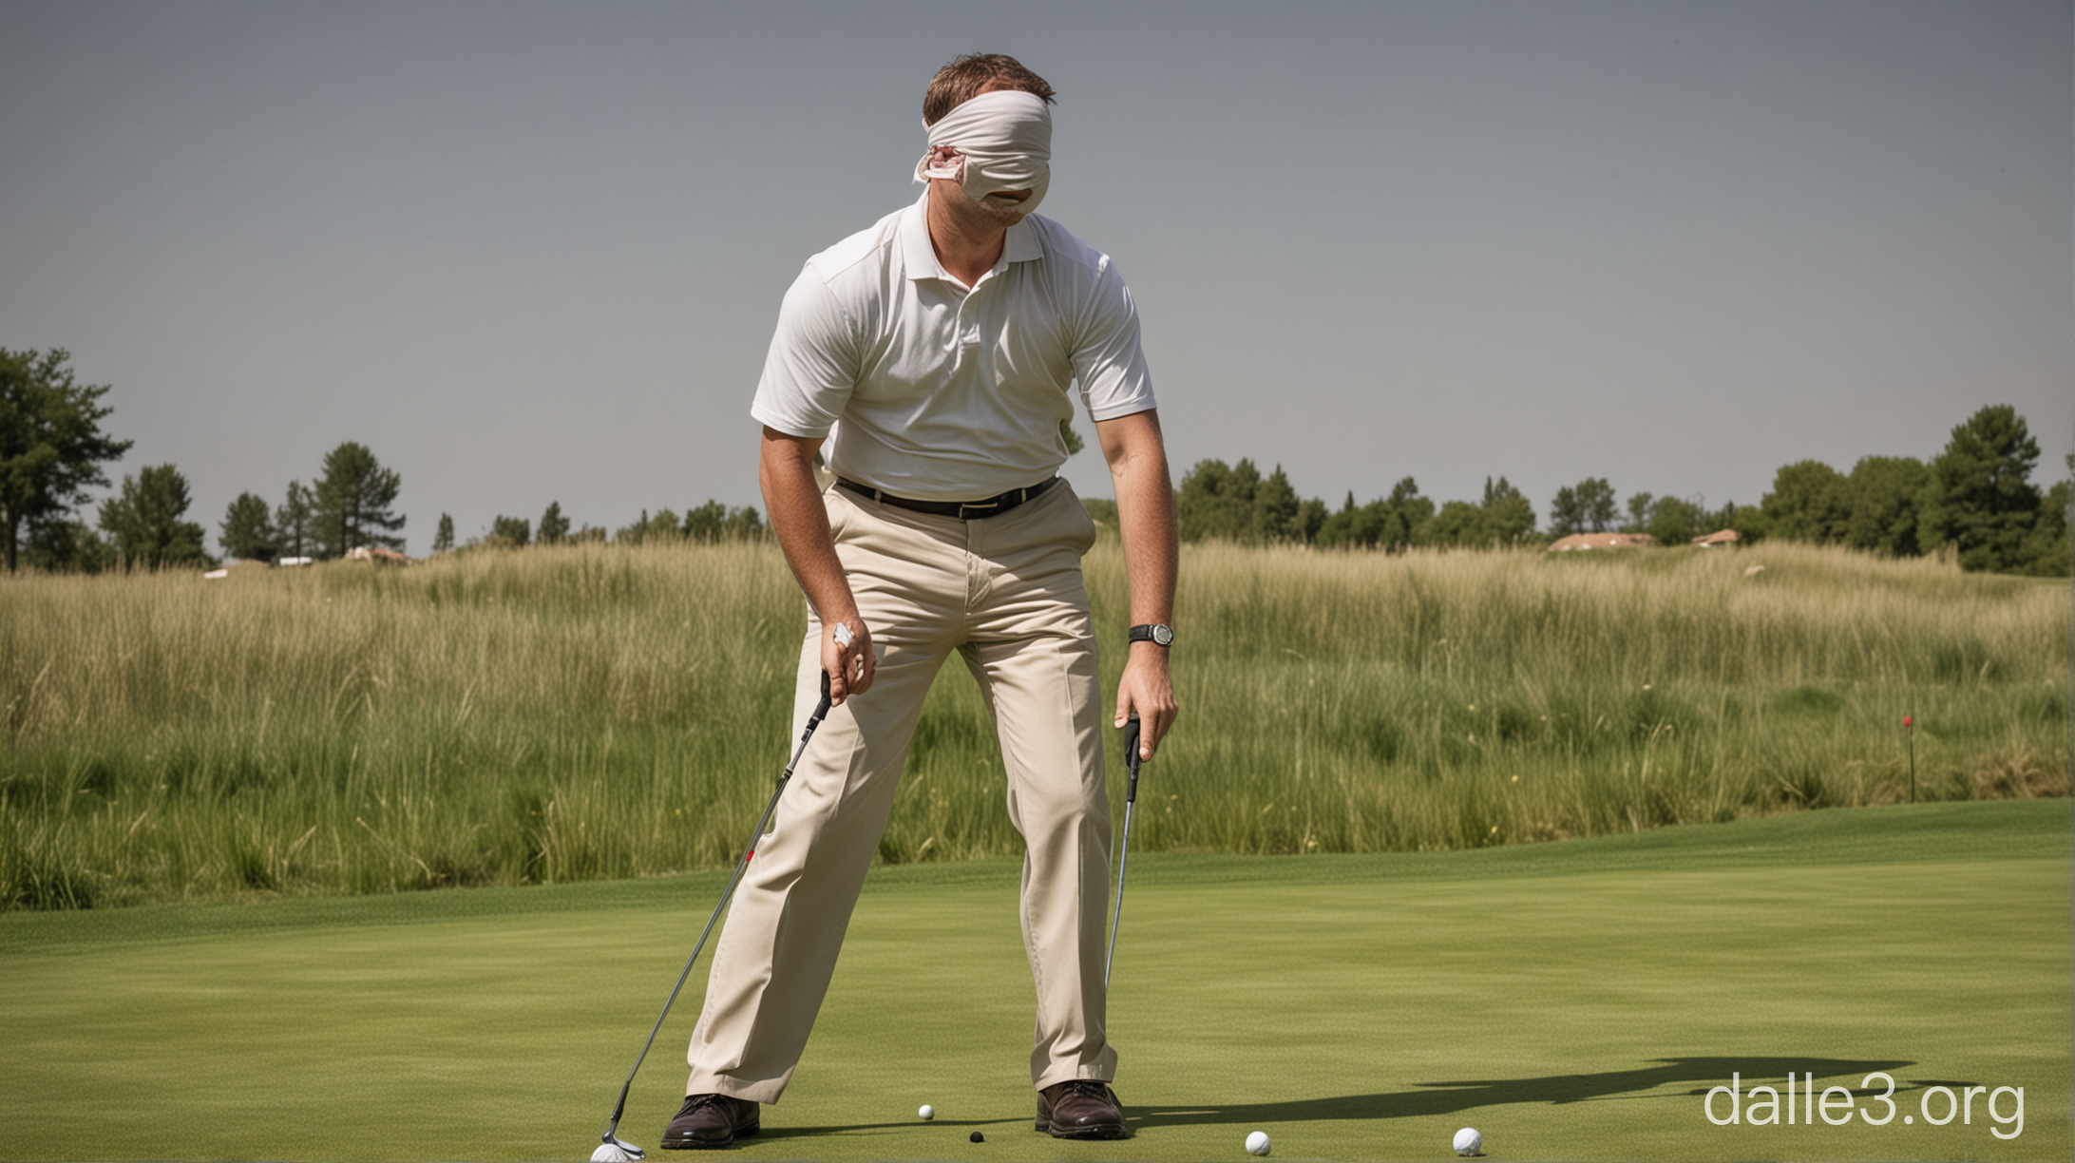

Slide 15


Slide 16


